Slide 1
OPS245 Week 3
Jonathan.ye@senecacollege.ca
Notes:
Review, preview and explain both of Linux administration and Python scripting.
After the 1st VM, we will create nested VM Hypervisor (host) in the C7host. KVM will host 3 more VMs while it is installed in C7host and nested in VMWare Workstation Pro V16.

Slide 2
Reasons to use a Virtual Machine
Virtual machines are not the future... They have existed for at least 2 decades.
One of the first uses of VMs were to create other OS environments in order to have programmers compile, run, and test software without having to use multiple physical machines, or restart with multiple boot menus.
Other uses of VMs have evolved to include:
Network Simulation (connecting VMs of various OS types)
Penetration testing (for network security)
Learning to use another OS (without having to reboot the computer).
Notes:
The most important reason is to remove dependency of hardware. The VM files can be copied again and again when the host system stops working and is replaced. Thus, VMs’ life is extended forever.

Slide 3
VMs in this Course
In OPS245, we will create three VMs in lab 2:
Centos1: Gnome Desktop GUI
Centos2: Command line only
Centos3: Command line only
You will use the same CentOS Full Install image for these machines. You will install a virtualisation tool called KVM to create and manage these VMs.
Notes:
Do you recall what installation options you can have when you install Linux or Windows OS onto the physical computers?

Slide 4
Preparing to Install a VM
There are a few steps to take on your Centos host to prepare for hosting nested VMs:
Telling the CPU to allow nested virtualisation
Making sure the machine is updated
Installing the KVM virtualisation software
Running the virtualisation software
Notes:
Top 3 VM hypervisor solutions are from VMWare, Citrix and Microsoft. Go to their website to collect information of product, service, license, cost, user experience/support.

Slide 5
Allowing Nested Virtualizaion
In this course your Centos host is a virtual machine itself, running inside VMware Workstation.
In later courses you will install it directly onto hardware.
To allow nested virtualisation (a VM inside a VM) you need to modify boot options and add kvm-intel.nested=1 in addition to the steps you already took in VMware.
Notes:
Please read Lab 2 instruction carefully.

Slide 6
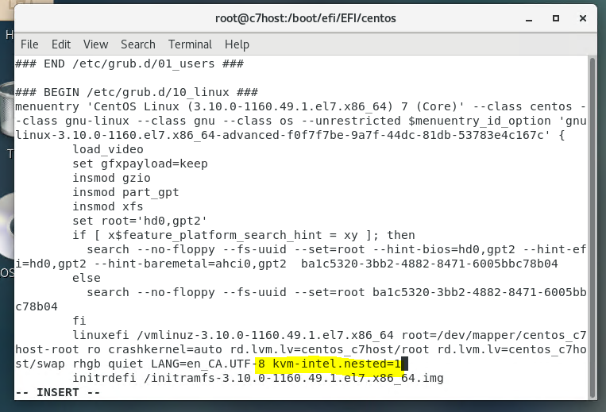
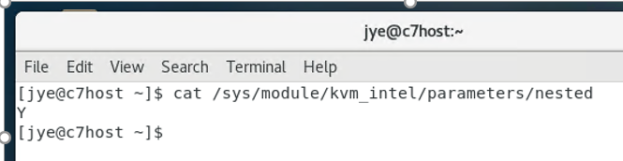
Enable nested parameter
Find your CPU
type. ☺ (Intel or AMD)
Notes:
You can use any editor such as vi or vim grub.cfg.
***Need to be slow to find the right place.

Slide 7
Installing KVM
First, make sure your machine is fully updated.
Then run
yum install qemu-kvm qemu-img virt-manager libvirt libvirt-python \ python-virtinst libvirt-client virt-install virt-viewer bridgu-utils
You will need elevated privileges to do so.
Enable the virtualisation service, then restart.
systemctl enable libvirtd
reboot
Again, you will need elevated privileges.
Due to changes to the kernel, you will not be able to run nested virtual machines until after you reboot, so do so now.

Slide 8
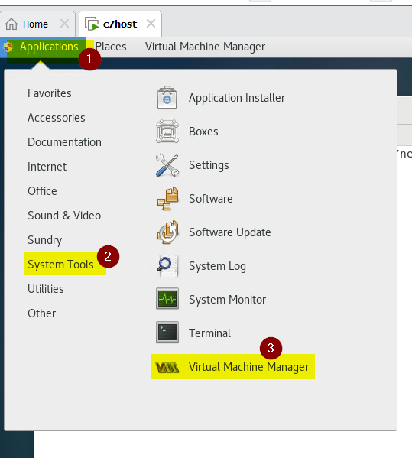
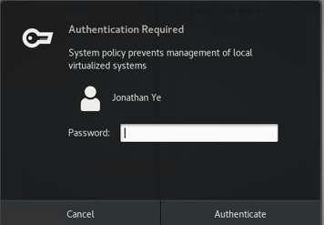
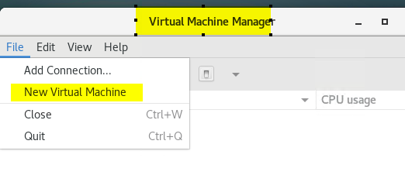
KVM Virtual Machine Manager
Notes:
The KVM virtual machine manager is the graphical program to create, install and manage your VMs.
You can run it from the menu:
Applications → System → Virtual Machine Manager
It needs root access, so it will prompt you for the root password

Slide 9
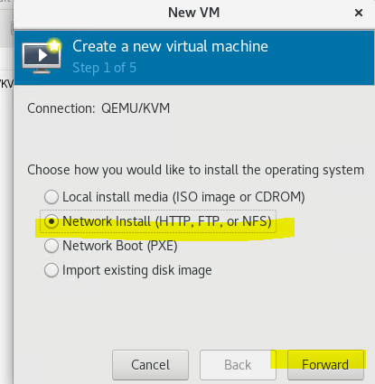
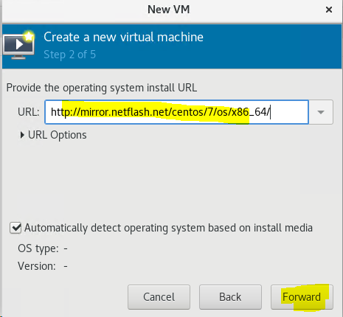
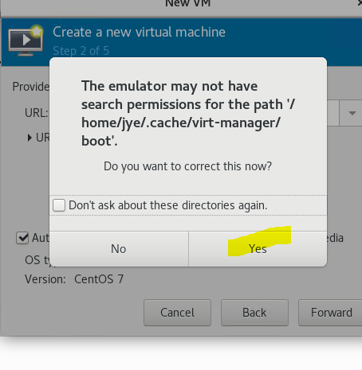
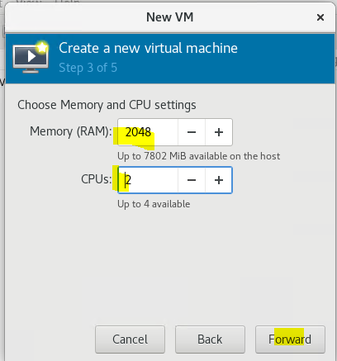
Creating a New VM
Follow the instructions in the lab to create all three virtual machines.
Note that you use different techniques for each one so you can learn different ways to install machines.
Notes:
Read the instructions carefully!
If you make a mistake you may need to wipe out the VM and start again:
Virtual Machine → Shutdown → Force Off
Then close the VM window, right click on the VM in Virtual Manager and select ‘Delete’
Check the box to delete its assigned storage.

Slide 10
User Names on Machines
In order to simplify this course, you will use the same usernames and passwords on your host and all three VMs.
If you do not, the shell scripts will not work correctly until you fix the user accounts.
While you could do so with the usermod command, for now it would be simpler to just delete the incorrect user and create a new one with useradd.
Notes:
Review those user account commands and become comfortable to operate without notes or google. ☺

Slide 11
Post Install Tasks
Just like your host machine, you will want to perform some post-installation tasks on the VMs.
Turn off the screen-saver (centos1 only)
Test internet connectivity
Get updates
Switch from firewalld to iptables
Set SELinux to permissive mode
Now if only you had a script that could do this...

Slide 12
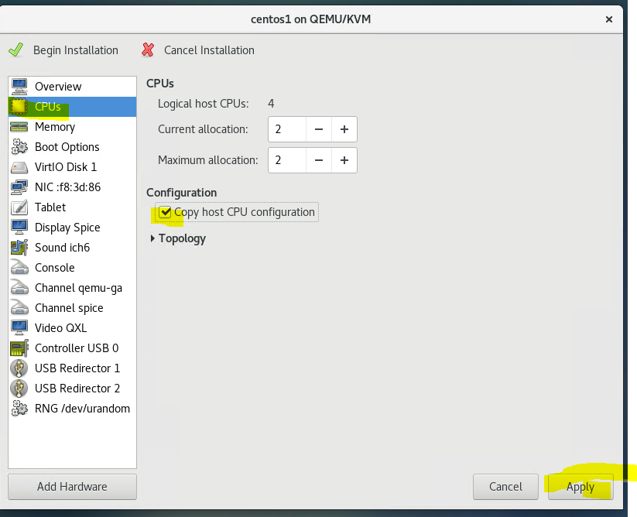
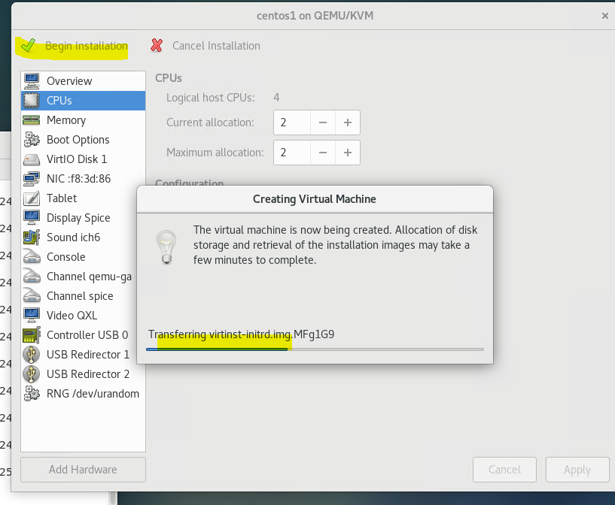
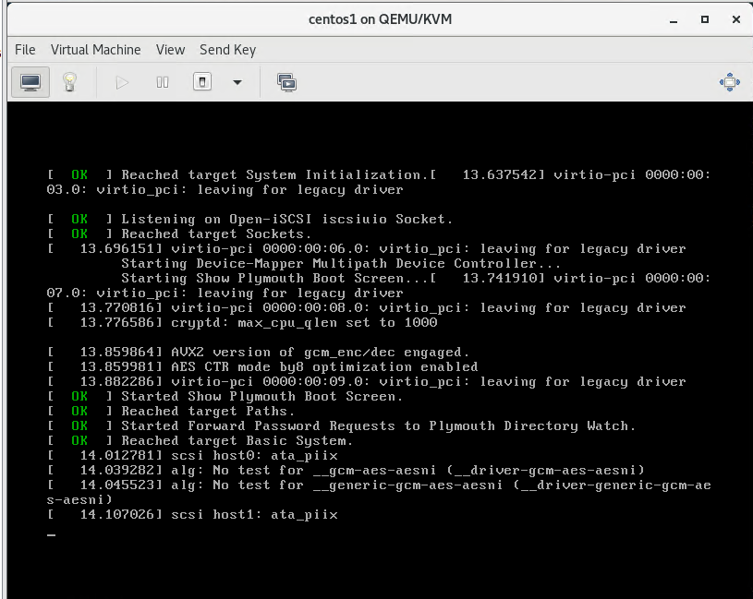
Some screenshots
Summary

Slide 13
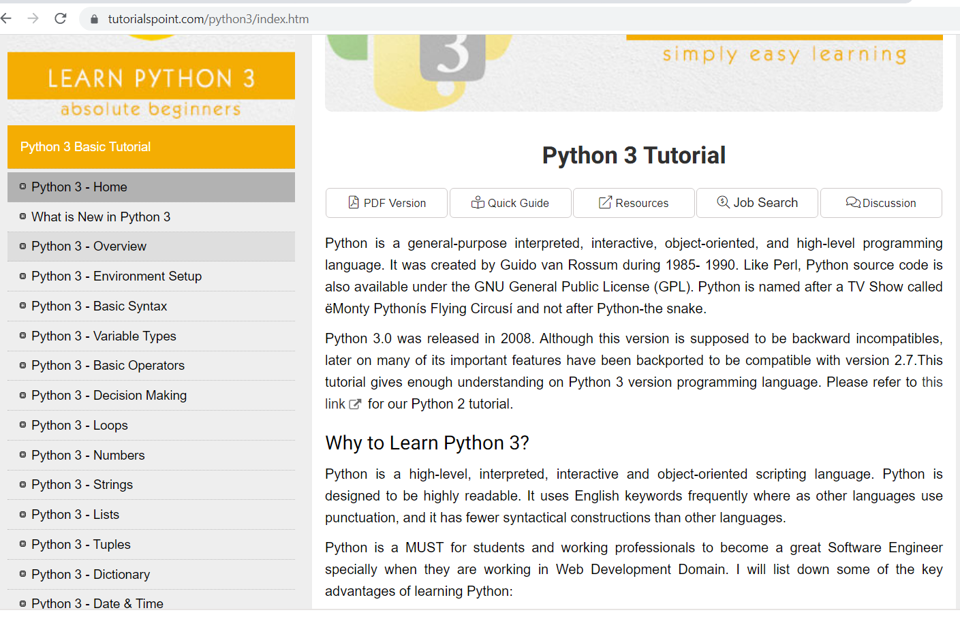
Outline
Python Logical Control
In this lesson you will continue to learn about python scripting by adding logical control statements
If, else, elif
Notes:
To explain the basic command syntax is not in my plan. Please go to python.org and youtube.com. If you cannot find any information in 2 min, talk to me in the class. I can help you to develop and polish searching skills.
One of examples is https://www.tutorialspoint.com/python3/index.htm

Slide 14
Control Flow Statements - Logic
Without the ability to make decisions, scripts would always perform the same task.
Never changing
See menu.py
Logical structures like if statements allow scripts to respond differently to different conditions.
Understanding the purpose and use of logical structures will allow you to make scripts that perform useful tasks and respond in a flexible manner.
Notes:
Computation logic can manage the commands flow based on predefined condition, user input or other factors:
Example 1: auto complete by running a bunch of commands – the essential script style
Example 2: control the computation based on the conditions. If user select option 1, run the 1st group of commands; if user chooses option 2, run the 2nd group of commands. …. If user selects option n, run the Nth group of commands. (Such operation can be achieved by [if, elif, elif, elif] or other option selection mechanism.
Example 3: keep the fortune wheel rotation until the user “say” stop.
Example 4: loop to search until finding the keywords (or lucky number). Think about the feature of FIND and REPLACE.

Slide 15
Decision Making
The process of decision making within a script requires that you check a condition.
e.g.
Do these strings match?
Are these numbers equal?
Is this file executable?
If that condition is True, the script runs some code, if not, it doesn't run it.
run if1.py (but don't look in it yet)
Notes:
***If it is possible to keep running something when the condition is FALSE. You can use the logical operator to manage the selection condition.
Below is the if1.py
#!/usr/bin/env python3
magic='42’
guess = input("Guess the magic number: ")
if magic == guess:
print(guess + " is correct!!")

Slide 16
If Statements
Just like in bash, python has if statements to allow us to run code only when certain conditions are met.
The format is:
if condition:
#block of code
If the condition is True, run the block of code.
If the condition is False, do not run the block of code.
Notes:
Compare below:
If compareNum==18:
print(“My lucky number is 18.”)
Vs
If compareNum!=18:
print(“Play it again”)

Slide 17
Conditions in Python
Strings, integers, and floats will use the same set of comparison conditions:
A == B – True if the value of A is equal to the value of B
A != B – True if the value of A is different than (not equal to) the value of B
A < B – True if the value of A is less than the value of B
A > B – True if the value of A is greater than the value of B
A <= B – True if the value of A is less than or equal to the value of B
A >= B – True if the value of A is greater than or equal to the value of B
For ints and floats, that’s pretty straightforward.
Notes:
Those ==, !=, <, >, >=, M= are logical operators.

Slide 18
String Comparisons
When using conditions with strings, the strings are compared character by character.
If they differ, the unicode value of the n^{th} character in each string is compared just like an int.
If one string is longer, but they match up to the end of the shorter string (e.g. ‘team’ and ‘teamwork’) the string with more characters is greater.
If they differ before that point, the character difference counts (e.g. tear and teamwork).
Letters later in the alphabet are ‘bigger’.
Notes:
Think about how you can compare two files:
Continuously compare strings in two files.
File operation is not mentioned now. But, it is critical to know:
Create file
Input or update contents
Save it or close the file
This is the process to create a report, log file or proof of any incident.

Slide 19
Indentation in Python
Notice the block of code inside the if statement was indented.
Unlike bash’s then and fi to define the block, python uses the indentation.
The end of the indented block is the end of the if statement.
With the exception of else, and elif.
Which do not get indented.
They behave the same way they did in bash.
Notes:
Neat format can help read the coding and understand its logics.

Slide 20
If statements - Else
Now that we have basic if statements and condition checking, we can move on to some more complex issues.
What if you want to run some code if a condition is True, but other code if it is False?
Perhaps check that a file exists. If it does, do something with it.
If it does not exist, warn the user and exit gracefully.
You can already do this with two separate if statements.
See twoIf.py
Notes:
#!/usr/bin/env python3
magic=42
guess = input("Guess the magic number: ")
intguess = int(guess)
if magic == intguess:
print(guess + " is correct!!")
if magic != intguess:
print("Sorry, " + guess + " is not correct.")

Slide 21
If Statements – Else cont.
Using multiple if statements in the way twoIf.py does works.
It is not outright 'wrong'
But it is inefficient.
You are checking the same condition twice.
There is special syntax to allow us to run a different block of code if the condition evaluates to False.
See if2.py
Notes:
#!/usr/bin/env python3
magic='42’
guess = input("Guess the magic number: ")
if magic == guess:
print(guess + " is correct!!")
else:
print("Sorry, " + guess + " is not correct.")

Slide 22
Nested If statements
The code that you run inside the block can be as complex or as simple as you need it to be.
The interior block can even include its own if statements as long as they are completely contained inside the outer if.
See if3.py
Note the several layers of indentation.
The internal if could even have its own else statements (and these could have internal ifs, etc).
See if4.py
Notes:
#!/usr/bin/env python3
#if3.py
magic=42
guess = input("Guess the magic number: ")
if magic == int(guess):
print(guess + " is correct!!")
else:
print("Sorry, " + guess + " is not correct.")
diff=magic - int(guess)
if diff > -5 and diff < 5:
print("Close though...")
+++
#!/usr/bin/env python3
#if4.py
magic=42
guess = input("Guess the magic number: ")
intguess =int(guess)
if magic == intguess:
print(guess + " is correct!!")
else:
print("Sorry, " + guess + " is not correct.")
diff=magic - intguess
if diff > -5 and diff < 5:
print("Close though...")
else:
print("Not even close.")

Slide 23
Elif statements in Python
The logic behind else and elif is the same as it was in bash:
If the original condition was False, you can check another condition with elif
If all the conditions (the original if, and any elifs) were false, the code after else gets run
if condition:
#block of code
elif anothercondition:
#a different block of code
elif maybeanothercondition:
#and another block of code to run
else:
#only if the conditions came back false.

Slide 24
Nested If Statements
If you need to nest if statements in python, just follow the indentation.
if grade >= 80:
print(‘That is an A’)
if grade >= 90:
print(‘Better yet, that is an A+’)
Notes:
You can do so. ☺
First baby step is to move. Then we can improve techniques. ☺

Slide 25
Boolean Variables
A Boolean variable has two possible values:
True or False
Like a light switch or a binary bit, it is ON or OFF.
When you’ve been using conditions they actually evaluate to a Boolean
5 == 5 is True
5 > 245 is False
Look back at the conditions you’ve used so far.
They will all evaluate to either True or False.

Slide 26
Compound Conditions
It is possible that what you are trying to check does not fit in a single normal condition.
Using or and and you can combine two conditions together.
if <condition> and <condition>:
if <condition> or <condition>:
These both combine the conditions on each side to evaluate the combined value to True or False
and | True | False
True | True | False
false | False | False
or | True | False
True | True | True
false | True | False

Slide 27
Find your examples
In this lesson you have learned how to use some logical control statements using python.
This allows your scripts perform differently under different conditions.
Notes:
Traffic lights: red – stop, green – move, yellow – keep moving or stop (one more condition to check if you pass the line)
Temp ranges: Cold, chill, normal, warm, hot
Grade: A (89%+), B, C, D, F (whatever percentage you like to give to them)
Speeding ticket fine: 1 – 14 km/h, 15-29 km/h, 30- 44 km/h, 45-59km/h (Those numbers can be different)

Slide 28
Question
???
Notes:
I cannot promise you to answer your email the same day. But, I will answer your question in the class now. ☺

Slide 29
Mini homeworks
No mark or bonus. But, good to do:
Find 3 Linux administration cases in which Python can help
Find at least 3 Python problem and solutions.
Notes:
Practice is the key to learn and build muscle memory.

